Slide 1
Module 8
Observational studies and data reporting

Slide 2
Lecture objectives
Recognize the various types of human observational studies
Know the pros and cons
Recognize the possible biases of observational studies
Be aware of various reporting guideline and standards

Slide 3
Registering studies
While the registering of randomized control trials has been the norm for a number of years, more recently, there is the option to register other types of studies, including observational studies and even in vitro studies.
In an effort to improve scientific data reporting, guidelines have been developed
Several journals offer study registration options
https://www.researchregistry.com/about
Q: Have you or someone in your lab ever registered a study?

Slide 4
Observational studies
Unlike during an experiment or an intervention study, in observational studies, investigators observe study participants and measure variables of interest without assigning treatments or interventions to the participants.
The treatment or exposure that each participant experiences is determined beyond the control of the investigator.
Example: Want to study the relationship between smoking in pregnancy and preterm delivery
Approach all consecutive pregnant women who present at a given clinic between 12 and 24 weeks of gestation. Ask them questions about their smoking habits. Determine their “due date” and record when they give birth.

Slide 5
Observational studies − types
Descriptive studies
- Case series
- Cross-sectional studies
Analytic studies
- Cohort studies
- Case-control studies

Slide 6
Observational studies − descriptive studies
Case report: A single patient with an interesting story (symptoms, signs, diagnosis)
To be taken with a grain of salt unless several similar case reports or case series emerge
Case series: A small group of patients (2+) with a similar diagnosis, condition, or treatment
Summary statistics: not applicable because the number “n” is too small

Slide 7
Observational studies − case report/series
PROS:
Can be the first indication of an epidemic or new pathogen
Can raise questions, inform and lead to new hypotheses
CONS:
Can be coincidental
No comparison group; cannot study associations
Often difficult to publish
Examples: - First report of gay men dying of unusual lung infection disease (HIV)
Reports of HIV+ people dying of lactic acidosis on antiretroviral therapy
Rare diseases, unusual disease presentation, rare reactions to vaccines
SARS

Slide 8
Observational studies − descriptive studies
Cross sectional studies: A study of all persons in the target population, or a representative sample of the population (cross-sectional = one time point per person).
Should be selected without regard to exposure or disease status
- All comers or a random selection
Individuals are then categorized into those with and without exposure or disease
A measure is done in all study participants and compared
Examples:
- Study a sample of HIV-infected and HIV-uninfected people (who ideally live in the same neighborhood and have similar socio-demographic characteristics), then investigate differences in telomere length, smoking rates, CVD, etc…at a given time

Slide 9
Observational studies − descriptive studies
Cross sectional studies: Example
Equal number of 60 yo men and women selected randomly from BC population
Living free of condition Condition = cardiovascular disease, HIV, cancer, etc.
Living with the condition Each line = 10 or 100 persons
Data collection
100 people per line: Prevalence = 500/1600 = 31.3% 95% CI = (29.0% – 33.5%)
10 people per line: Prevalence = 50/160 = 31.3% 95% CI = (24.0% – 38.5%)

Slide 10
Observational studies − cross-sectional studies
Living free of condition
Living with the condition
Data collection
dashed = male, solid = female
Sex | Living free of condition | Living with the condition | Total
Male | 200 | 600 | 800
Female | 700 | 100 | 800
Total | 900 | 700 | 1600
Prevalence ratio among persons with condition = 600/800 ÷ 100/800 = 6.0
→ The proportion of people with the condition is 6-fold greater if the person is of male sex

Slide 11
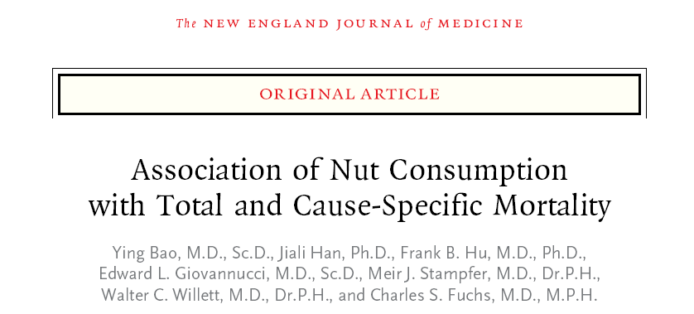

Observational studies − cross-sectional study

Slide 12
Observational studies − cross-sectional studies
Summary statistics:
can measure prevalence (with 95% CI) or the proportion of a population found to have a condition
can measure the prevalence ratio (with 95% CI) or the ratio of the prevalence in two sub-groups
Advantages:
Provides estimates of prevalence
Good for describing variables and their distribution
Can examine associations
Typically faster study (all observations at once)
Less expensive than other types of studies
Disadvantages:
May not be representative of all cases in the target population
Can not establish causal relationship. Which came first? Exposure or disease?
Provides limited information on what it means for the future

Slide 13
Cross-sectional studies − biases
Selection bias:
When people recruited in a study do not represent the cases in the population
Can be influenced by
a) competing risk (e.g. recruiting people who have a lower risk of the condition) b) healthcare access bias (e.g. can’t study those not engaged in care) c) inclusion or exclusion criteria (e.g. excluding controls with conditions related to the exposure) d) relative bias (e.g. relatives are more likely to share conditions)
People accepting to participate in research may just be different

Slide 14
Cross-sectional studies − biases
Length bias:
When people identified with condition will over-represent those with a long duration of the condition and under-represent those with a short duration of the condition
Could lead to confusion and make a factor related to disease duration seem like a factor related to disease occurrence
Especially true in pediatric studies of diseases with high mortality rates
Survival bias:
When people identified with condition will over-represent those who survived it (and are therefore still alive to participate in the study)

Slide 15
Cross-sectional studies − biases
Data collection
Data collection
Prevalence = 500/1600 = 31.3% 200/1300 = 15.4%

Slide 16
Observational studies − analytical studies
Cohort studies:
A group of individuals (cohort) who share a common characteristic (e.g. free of disease of interest at baseline, or who all have a disease such as HIV infection) and are studied over time (e.g. for their disease risk factors, or their HIV treatment) to ascertain incidence (of disease of interest, or of disease outcome such as AIDS)
OR
Two groups of individuals (cohorts) that differ (e.g. males vs females, or individuals who acquired HIV through sexual contact vs through maternal vertical transmission)
Can be prospective: watches for outcomes, such as the development of a disease, during the study period and relates this to other factors.
Can be retrospective: looks backwards and examines exposures to suspected risk or protection factors in relation to an outcome that is established at the start of the study
Prospective studies usually have fewer potential sources of bias and confounding than retrospective studies.

Slide 17
Observational studies − cohort studies
Cohort studies: Example
Equal number of 60 yo men and women without the condition selected randomly from BC population
One study visit each year following enrollment in the cohort, many parameters measured
Living free of condition Condition = cardiovascular disease, HIV, cancer, etc.
= Data collection
Living with the condition Each line = 100 persons
baseline
Incidence = X % 95% CI = ?

Slide 18
Observational studies − cohort studies
Summary statistics:
incidence rates, (with 95% CI) or the number of new cases per population at risk in a given time period
incidence ratio (with 95% CI) or the ratio of the incidence rate in two sub-groups
cumulative incidence ratios if time-to-data is available

Slide 19
Cohort studies − Pros & Cons
PROS:
Provides estimates of incidence of disease (in addition to prevalence)
Exposure precedes disease (temporal)
If prospective, have the opportunity to measure important factors accurately and completely
CONS:
Likely large and expensive
Not good for the study of rare diseases or infrequent outcomes
Subject to biases as are all observational studies
Recall bias
Desirability bias

Slide 20
Observational studies − longitudinal cohort studies
Cohort studies can allow the study of an exposure within individual, enhancing the ability to make associations because each participant can act as their own control
Example: Want to study relationship between smoking and IL-6 levels:
Cross-sectional study
Longitudinal cohort study
Cohort participants
Cohort participants
At t=X
smokers
non-smokers
smokers
non-smokers
IL-6 different?
quitters
non-quitters
IL-6 different?
(many other factors could be at play)
IL-6 different?
ΔIL-6?
ΔIL-6?

Slide 21
Observational studies − case control studies
Sampling (assignment to groups) is based on an outcome or a characteristic.
Case-control studies start with the identification (in a given population) of a group of cases (individuals with a particular health outcome) and a group of controls (individuals without the health outcome) to be included in the study.
exposed
unexposed
exposed
unexposed
Cases
Controls
The prevalence of exposure to a potential risk factor(s) or the prevalence of a characteristic is compared between cases and controls

Slide 22
Observational studies − case control studies
Cases can be:
incident (i.e. new diagnosis → preferable)
prevalent (people who already have a diagnosis for various periods of time → more recall bias about exposure)
Selection of a comparable control group is important, ideally a random sample from the general population that gave rise to the cases
If the cases tend to have different characteristics than the general population (e.g. disease risk related to ancestry, where one lives, social determinants of health), then it may become important that controls share these same characteristics
The procedures used for the collection of exposure data should be the same for cases and controls (e.g. medical chart, self-report, administrative health data)
If the cases and controls are from within a cohort study, would be described as a “nested” case control study

Slide 23
Observational studies − case control studies
Example: Cases are women who had premature delivery (<37 weeks of gestation) and controls are women who delivered at term (≥37 weeks of gestation). The effect of smoking is investigated.
 | Pre-Term Delivery (CASES) | Term Delivery (CONTROLS)
Smoker | A | B | A+B
Non-smoker | C | D | C+D
 | A+C | B+D | A+B+C+D
Summary statistics: Odds and odds ratios (OR) (with 95% CI)
OR = odds of smoking among cases = (A/(A+C)) / (C/(A+C))
odds of smoking among controls (B/(B+D)) / (D/(B+D))

Slide 24
Case-control studies − PROS and CONS
PROS:
Cost effective relative to cohort studies
Because cases are identified at the beginning of the study → no long follow up period
Good to study rare diseases or diseases with long latency periods
Can examine multiple exposures
CONS:
Particularly prone to bias; especially selection, recall and observer biases
Limited to examining one outcome at a time
Cannot estimate incidence rates of disease (unless study is population based)
Not good for the study of rare exposures
Timing between exposure and disease may be difficult to establish

Slide 25
Observational studies − limitations
Observational studies are often derided and said to be tainted by data dredging, confounding and bias (compared to randomized controlled trials = gold standard)
Q: What is the main difference between observational studies and randomized controlled trials (RCT)?
Limitations:
Data dredging: look at everything under the sun until you find an association
Confounding and bias: related to humans (behaviour, socio-economic status, others) and how the participants were selected
Indeed, some observational studies showed effects that were either misguided or not verified by large controlled studies
RCT are considered the gold standard for evidence-based medicine BUT…RCT often enroll participants that are not fully representative of the “real world”

Slide 26
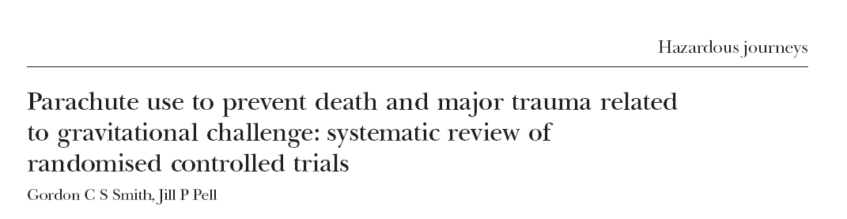
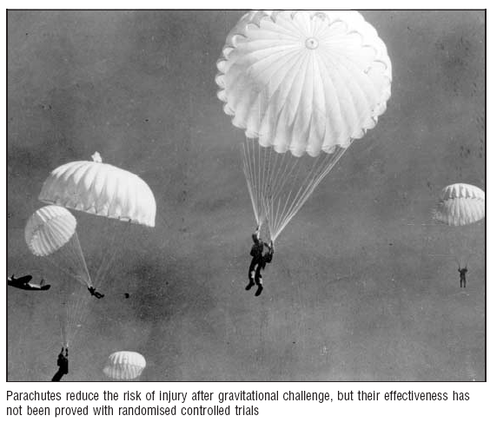
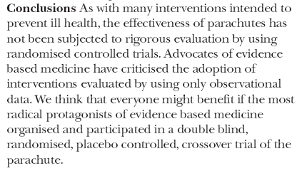
Observational studies – sometimes the only tool
Observational studies can still inform and are sometimes the only tool available

Slide 27
Observational studies − limitations
Example: Effect of smoking in pregnancy: unlikely that one will do a randomized controlled study where half the pregnant women are assigned to smoke in pregnancy
→ Observational study results should be independently replicated/validated
→ If an effect/association is seen in one cohort, another independent cohort should investigate whether the same association is also observed (less easy to get $)

Slide 28
Observational studies − sensitivity analyses
When there is a doubt that a factor might be creating bias, a sensitivity analysis can be done to try and tease out whether this is the case
For example, a variable may play a role but is missing for many participants, or another variable is suspected to influence the true relationship between an outcome and a given factor.
Can try to do the analysis with and without that variable and see how it changes the statistical model (i.e. restrict the analysis to a subgroup to eliminate the effect of the missing or confounding variable).
Can restrict a sensitivity analysis to a sub-group (e.g. one sex, one ethnic group, etc.)
Often, when reviewers challenge authors on a given point, a sensitivity analysis is done that was not necessarily part of the original analysis plan
When reporting, authors should be transparent as to whether it was a planned sensitivity analysis or one that was triggered by results from the primary analysis

Slide 29
Observational studies statistical vs. clinical or biological significance
With large studies, it may be easy to demonstrate a significant effect but the effect may be very small = what is the biological or clinical significance?
Always consider the “effect size” along with the precision of this estimate, not only the statistical significance or p value.
Effect size = your estimate (e.g. mean or odd ratio)
Precision of the estimate = 95% CI
Then interpret what it means biologically or clinically.

Slide 30
Reporting guidelines
In an effort to improve scientific data reporting, guidelines have been developed
Many journals now require that these guidelines be followed when reporting, usually mentioned in the “instructions to authors”
Most guidelines are summarized in a useful single website called EQUATOR
“Enhancing the QUAlity and Transparency Of health Research”
http://www.equator-network.org/
Q1: Have you ever heard of STROBE, CONSORT, STARD or ARRIVE?
If so which one?
Strongly recommend you read those relevant to your type of work BEFORE you start collecting data and revisit again BEFORE you submit your manuscript

Slide 31
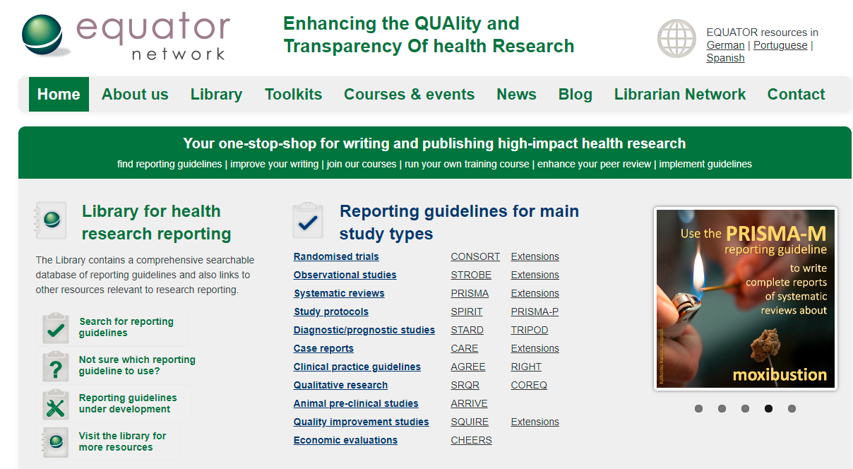
https://www.equator-network.org/

Slide 32

STROBE statement
International, collaborative initiative of epidemiologists, methodologists, statisticians, researchers and journal editors involved in the conduct and dissemination of observational studies, with the common aim of STrengthening the Reporting of OBservational studies in Epidemiology. Similar to CONSORT but adapted to observational studies
Endorsed by most reputable journals and required by many top journals
Provides a checklist of items that should be included in reports of observational studies (should be checked BEFORE embarking on an observational study)
It is something you will also want to use for your PATH 548L presentation if you are doing an observational human study.
http://www.strobe-statement.org/pdf/index.php?id=available-checklists

Slide 33
STROBE statement − checklist
Item 1 (Title and abstract): Indicate the study’s design with a commonly used term in the title or the abstract, provide in the abstract an informative and balanced summary of what was done and what was found
Item 2 (Background/ rationale): Explain the scientific background and rationale for the investigation being reported
Item 3 (Objectives): State specific objectives, including any pre-specified hypotheses
Item 4 (Study design): Present key elements of study design early in the paper (cohort study, cross-sectional, prospective vs. retrospective, etc.)
Item 5 (Setting): Describe the setting, locations, and relevant dates, including periods of recruitment, exposure, follow-up, and data collection
http://www.strobe-statement.org/fileadmin/Strobe/uploads/checklists/STROBE_checklist_v4_combined.pdf

Slide 34
STROBE statement − checklist
Item 6 (Participants): Give the eligibility criteria, and the source and methods of selection of participants. If case-control study, give the rationale for choice of cases and controls. If a matched study, give matching criteria and number of controls per case
Item 7 (Variables): Clearly define all outcomes, exposures, predictors, potential confounders, and effect modifiers. Give diagnostic criteria, if applicable
Item 9 (Bias): Describe any efforts to address potential sources of bias
Item 10 (Study size): Explain how the study size was arrived at
Item 11 (Quantitative variables): Explain how quantitative variables were handled in the analyses. If applicable, describe which groupings were chosen and why
http://www.strobe-statement.org/fileadmin/Strobe/uploads/checklists/STROBE_checklist_v4_combined.pdf

Slide 35
STROBE statement − checklist
Item 12 (Statistical methods):
(a) Describe all statistical methods, including those used to control for confounding
(b) Describe any methods used to examine subgroups and interactions
(c) Explain how missing data were addressed
(d) Cohort study—If applicable, explain how loss to follow-up was addressed
Case-control study—If applicable, explain how matching of cases and controls was
addressed
Cross-sectional study—If applicable, describe analytical methods taking account of
sampling strategy
(e) Describe any sensitivity analyses
Item 13 (Participants):
(a) Report numbers of individuals at each stage of study—e.g. numbers potentially eligible,
examined for eligibility, confirmed eligible, included in the study, completing follow-up, and analysed
(b) Give reasons for non-participation at each stage
(c) Consider use of a flow diagram
http://www.strobe-statement.org/fileadmin/Strobe/uploads/checklists/STROBE_checklist_v4_combined.pdf

Slide 36
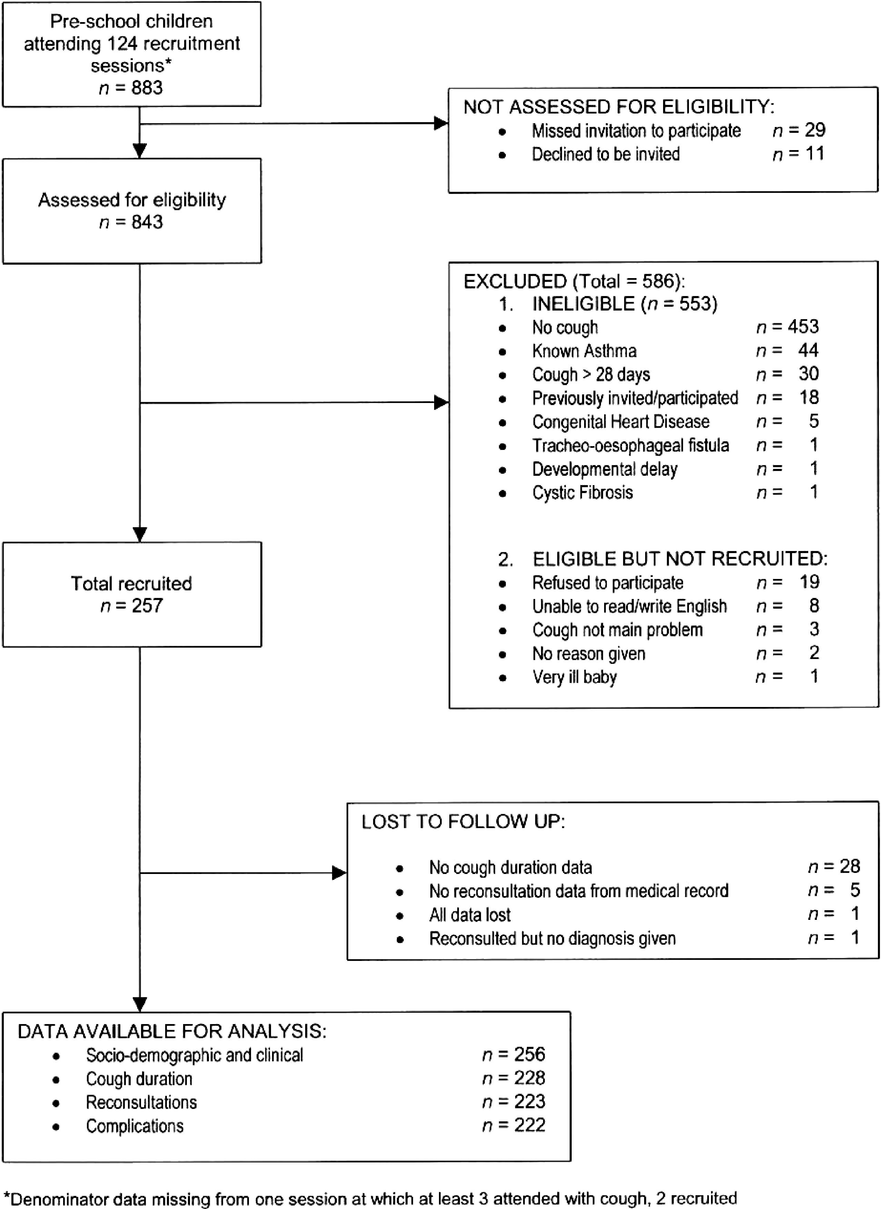
https://journals.plos.org/plosmedicine/article?id=10.1371/journal.pmed.0040297

Slide 37
Non-pregnant women and girls >12 enrolled in CARMA (Dec 2008 – Aug 2017)
328 HIV+, 318 HIV-
No blood collected
Excluded 1 HIV+
Participants with blood specimens for ≥1 visit
327 HIV+, 318 HIV-
Missing essential demographic or clinical data
Excluded 15 HIV+, 18 HIV-
Participants included in cross-sectional analyses
312 HIV+, 300 HIV-
<2 visits that were ≥1 year apart
Excluded 84 HIV+, 232 HIV-
Participants included in longitudinal analyses
228 HIV+, 68 HIV-
Figure S1. Study participant selection schematic.
Hsieh AYY et al., submitted

Slide 38
STROBE statement − checklist
Item 14 (Descriptive data):
(a) Give characteristics of study participants (e.g. demographic, clinical, social) and information on exposures and potential confounders
(b) Indicate number of participants with missing data for each variable of interest
(c) Cohort study—Summarise follow-up time (e.g., average and total amount)
Item 16 (Main results):
(a) Give unadjusted estimates and, if applicable, confounder-adjusted estimates and their
precision (e.g., 95% CI). Make clear which confounders were adjusted for and why they were included
(b) Report category boundaries when continuous variables were categorized
(c) If relevant, consider translating estimates of relative risk into absolute risk for a meaningful time period
Item 17 (Other analyses): Report other analyses done—e.g. analyses of subgroups and interactions, and sensitivity analyses
http://www.strobe-statement.org/fileadmin/Strobe/uploads/checklists/STROBE_checklist_v4_combined.pdf

Slide 39
STROBE statement − checklist
Item 19 (Limitations): Discuss limitations of the study, taking into account sources of potential bias or imprecision. Discuss both direction and magnitude of any potential bias
Item 20 (Interpretation): Give a cautious overall interpretation of results considering objectives, limitations, multiplicity of analyses, results from similar studies, and other relevant evidence
Item 21 (Generalisability): Discuss the generalisability (external validity) of the study results
Item 22 (Funding): Give the source of funding and the role of the funders for the present study and, if applicable, for the original study on which the present article is based
Good idea to mention in your cover letter to the Journal Editor that you followed a given guideline
http://www.strobe-statement.org/fileadmin/Strobe/uploads/checklists/STROBE_checklist_v4_combined.pdf

Slide 40
ARRIVE guidelines − checklist
The ARRIVE Guidelines Checklist Animal Research: Reporting In Vivo Experiments
Items 1-4 similar to STROBE
Item 5 (Ethical statement): Indicate the nature of the ethical review permissions
Item 6 (Study design): For each experiment, give brief details of the study design including:
a. The number of experimental and control groups.
b. Any steps taken to minimize the effects of subjective bias when allocating animals to treatment (e.g. randomization procedure) and when assessing results (e.g. if done, describe who was blinded and when).
c. The experimental unit (e.g. a single animal, group or cage of animals).
A time-line diagram or flow chart can be useful
https://www.nc3rs.org.uk/sites/default/files/documents/Guidelines/NC3Rs%20ARRIVE%20Guidelines%20Checklist%20%28fillable%29.pdf

Slide 41
ARRIVE guidelines − checklist
Item 7 (Experimental procedures): For each experiment, provide precise details of all procedures carried out
a. How (e.g. drug formulation and dose, site and route of administration, anaesthesia and analgesia used, surgical procedure, method of euthanasia). Provide details of any specialized equipment used
b. When (e.g. time of day)
c. Where (e.g. home cage, laboratory, water maze)
d. Why (e.g. rationale for choice of specific anaesthetic, route of administration, drug dose used).
Item 8 (Experimental animals): a. Provide details of the animals used, including species, strain, sex, developmental stage and weight b. Provide further relevant information such as the source of animals, international strain nomenclature, genetic modification status (e.g. knock-out or transgenic), genotype, health/immune status, drug or test naïve, previous procedures, etc.
https://www.nc3rs.org.uk/sites/default/files/documents/Guidelines/NC3Rs%20ARRIVE%20Guidelines%20Checklist%20%28fillable%29.pdf

Slide 42
ARRIVE guidelines − checklist
Item 9 (Housing and husbandry): Provide details of:
a. Housing (type of facility e.g. specific pathogen free [SPF]; type of cage or housing; bedding material; number of cage companions; tank shape and material etc. for fish)
b. Husbandry conditions (e.g. breeding programme, light/dark cycle, temperature, quality of water etc.
c. Welfare-related assessments and interventions that were carried out prior to, during, or after the experiment.
Items 10 (Sample size): a. Specify the total number of animals used in each experiment, and the number of animals in each experimental group
b. Explain how the number of animals was arrived at
c. Indicate the number of independent replications of each experiment, if relevant.
Items 11 (Allocating animals to experimental groups): a. Give full details of how animals were allocated to experimental groups, including randomisation or matching if done.
b. Describe the order in which the animals in the different experimental groups were treated and assessed
https://www.nc3rs.org.uk/sites/default/files/documents/Guidelines/NC3Rs%20ARRIVE%20Guidelines%20Checklist%20%28fillable%29.pdf

Slide 43
ARRIVE guidelines − checklist
Items 12 (Experimental outcomes): Clearly define the primary and secondary experimental outcomes assessed (e.g. cell death, molecular markers, behavioural changes)
Items 13 (Statistical methods): a. Provide details of the statistical methods used for each analysis b. Specify the unit of analysis for each dataset (e.g. single animal, group of animals, single neuron) c. Describe any methods used to assess whether the data met the assumptions of the statistical approach.
Items 14 (Baseline data): For each experimental group, report relevant characteristics and health status of animals (e.g. weight, microbiological status, and drug or test naïve) prior to treatment or testing. (This information can often be tabulated).
Item 15 (Numbers analyzed): a. Report the number of animals in each group included in each analysis. Report absolute numbers (e.g. 10/20, not 50%)
b. If any animals or data were not included in the analysis, explain why.
https://www.nc3rs.org.uk/sites/default/files/documents/Guidelines/NC3Rs%20ARRIVE%20Guidelines%20Checklist%20%28fillable%29.pdf

Slide 44
ARRIVE guidelines − checklist
Items 16 (Outcomes and estimation): Report the results for each analysis carried out, with a measure of precision (e.g. SEM or confidence interval).
Items 17 (Adverse events): a. Give details of all important adverse events in each experimental group b. Describe any modifications to the experimental protocols made to reduce adverse events.
Items 18 (Interpretation/scientific implications):
a. Interpret the results, taking into account the study objectives and hypotheses, current theory and other relevant studies in the literature
b. Comment on the study limitations including any potential sources of bias, any limitations of the animal model, and the imprecision associated with the results c. Describe any implications of your experimental methods or findings for the replacement, refinement or reduction (the 3Rs) of the use of animals in research.
Item 19 (Generalisability/ translation): Comment on whether, and how, the findings of this study are likely to translate to other species or systems, including any relevance to human biology.
Item 20 (Funding): Report all funding sources
https://www.nc3rs.org.uk/sites/default/files/documents/Guidelines/NC3Rs%20ARRIVE%20Guidelines%20Checklist%20%28fillable%29.pdf

Slide 45
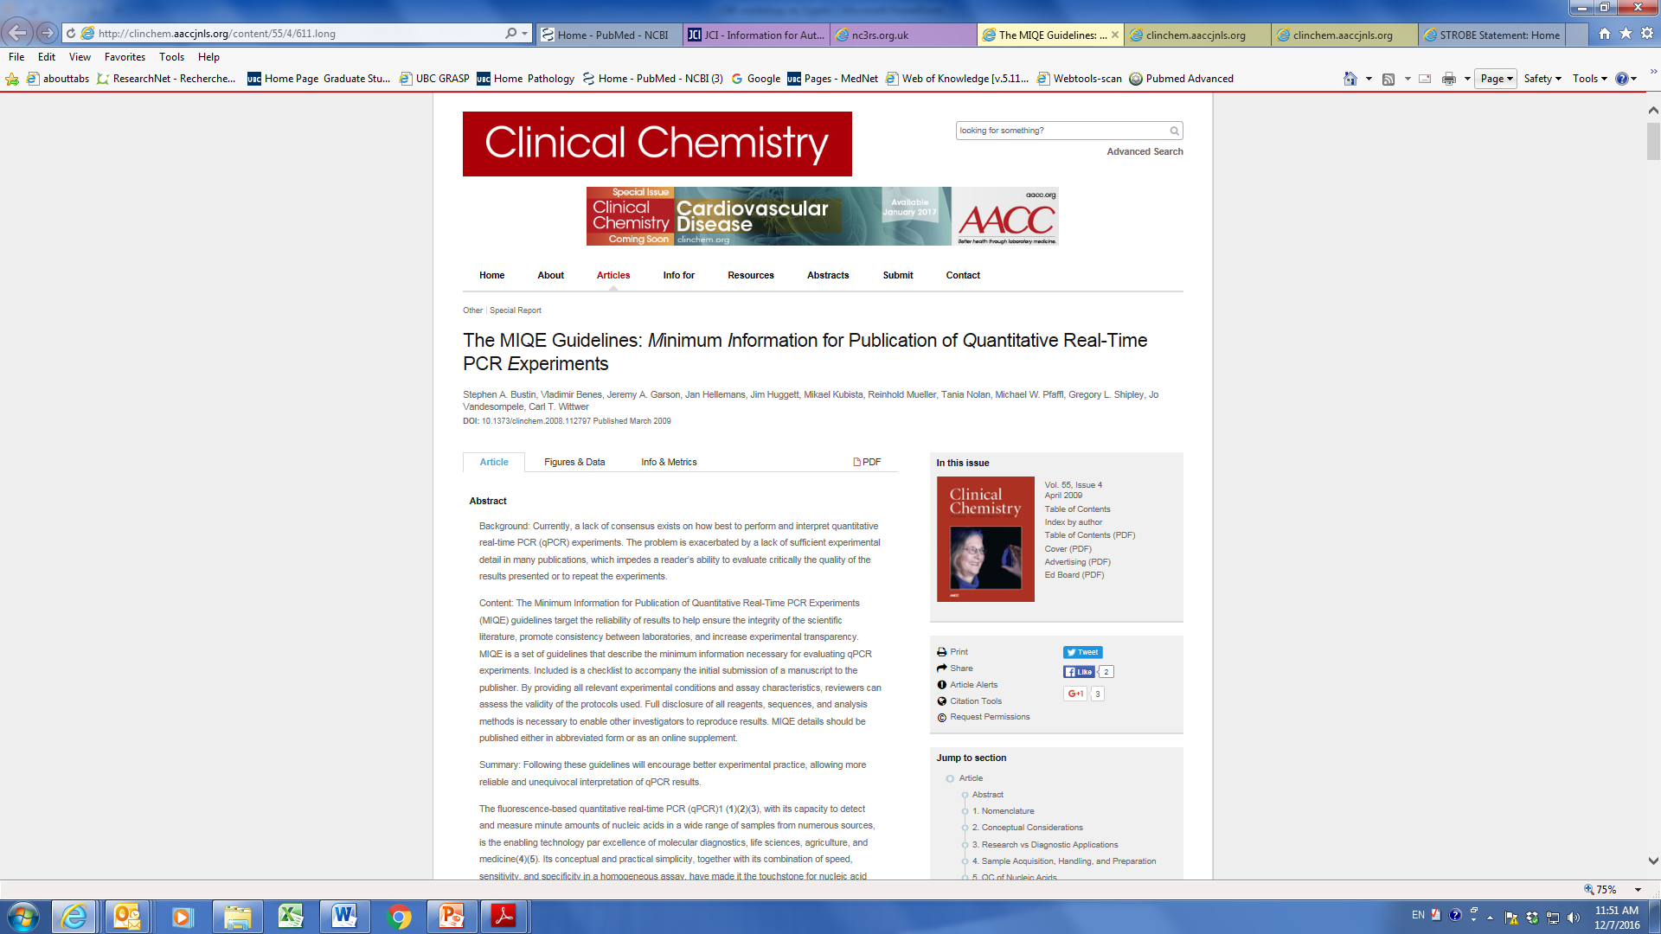
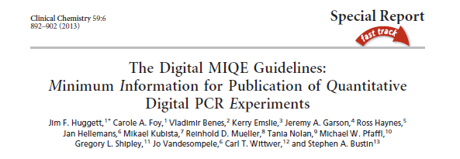
Other guidelines: qPCR studies

Slide 46
Other guidelines: tumour marker studies

Slide 47
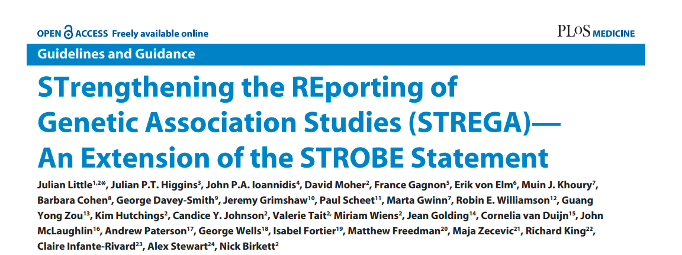
Other guidelines: Genetic association studies

Slide 48
Mann CJ. Observational research methods. Research design II: cohort, cross sectional, and case-control studies. BMJ (2003) Emerg Med J 20:54 https://emj.bmj.com/content/emermed/20/1/54.full.pdf
Festing MFW & Altman DG. Guidelines for the design and statistical analysis of experiments using laboratory animals. ILAR Journal (2002) 43(4): 244 http://ilarjournal.oxfordjournals.org/content/43/4/244.full.pdf
Sibbald B et al., Understanding controlled trials: Why are randomised controlled trials important? BMJ (1998) 316:201 http://www.ncbi.nlm.nih.gov/pmc/articles/PMC2665449/pdf/9468688.pdf
Lecture on RCT at International HIV conference (CROI 2014) by Dr. Richard J. Hayes, Studying Multiple Interventions: Factorial Designs and Other Approaches (tenofovir and Truvada are HIV drugs, TB is tuberculosis) http://www.croiwebcasts.org/console/player/22018?mediaType=audio&
Heyland et al. Glutamine and antioxidants in critically ill patients http://www.nejm.org/doi/pdf/10.1056/NEJMoa1212722 EQUATOR network (Enhancing the QUAlity and Transparency Of health Research http://www.equator-network.org/reporting-guidelines/stard/
Hooijmans CR et al., A Gold Standard Publication Checklist to Improve the Quality of Animal Studies, to Fully Integrate the Three Rs, and to Make Systematic Reviews More Feasible. (2010) ATLA 38:167
Shaw et al. Use of factorial designs to optimize animal experiments and reduce animal use. (2002) ILAR Journal 43(4): 223 http://ilarjournal.oxfordjournals.org/content/43/4/223.full.pdf

